Slide 1

Shelling Out the Differences: How Age Shapes Loggerhead Turtle Microbiomes
Jordan Thesier
04/30/25
Notes:
Loggerhead sea turtles
How age shapes their microbiomes

Slide 2
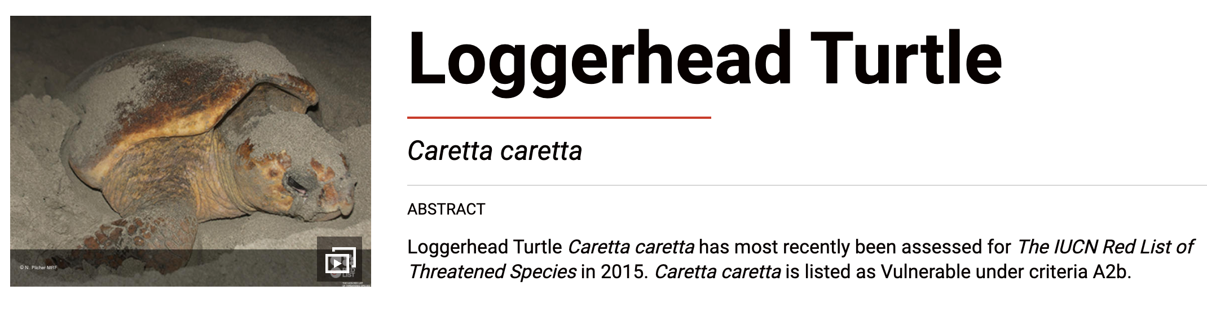
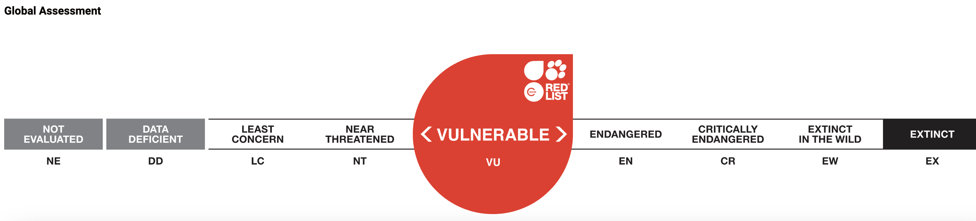
Loggerhead sea turtles (Caretta caretta) are a Threatened Species
iucnredlist.org/species/3897/119333622
Esha Patel et al. 2022
Notes:
Loggerhead sea turtles are classified as a vulnerable species on the IUCN Red List of Threatened Species (International Union for the Conservation of Nature)
Meaning it has a high risk of extinction in the wild
Its is also under the protection of the Endangered Species Act

Slide 3
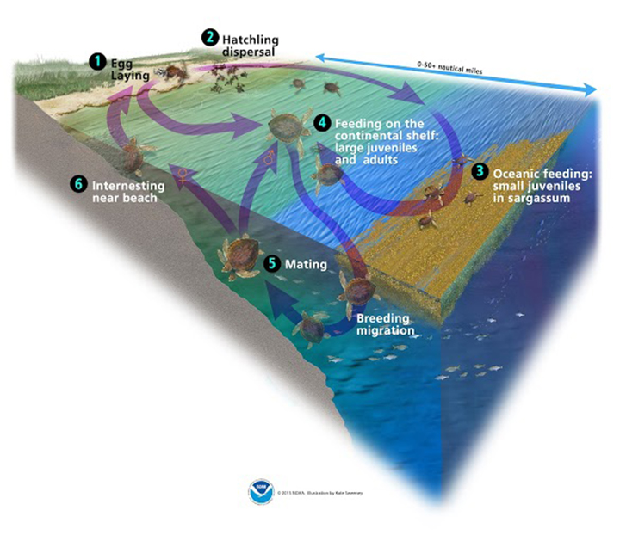
Loggerhead sea turtles (Caretta caretta) are a Threatened Species
iucnredlist.org/species/3897/119333622
Esha Patel et al. 2022
Notes:
Keystone species – maintain seagrass beds through grazing, leads to increased water flow and aeration of sediments preventing anoxia. Removal of seagrass also prevents accumulation of algae and algal blooms. They nest at coasts, introducing marine nutrients and energy to these coasts and are important for nutrient cycling.

Slide 4
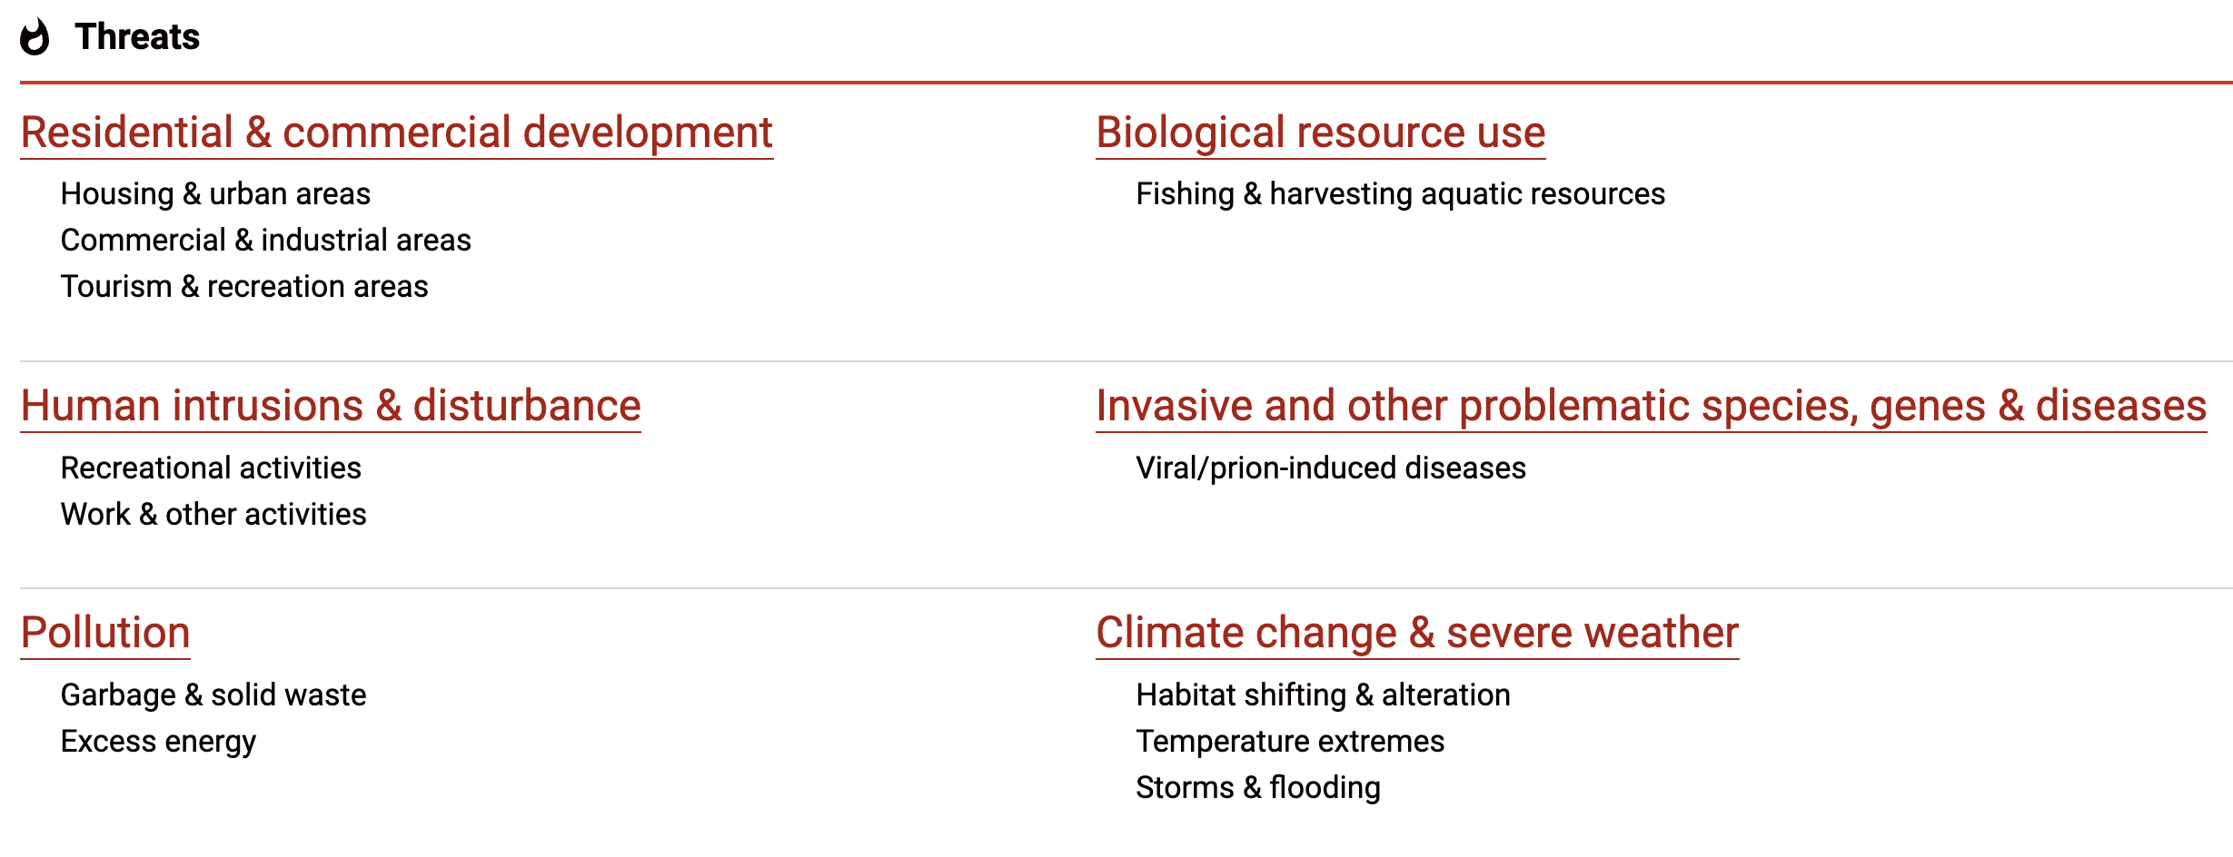
Loggerhead sea turtles (Caretta caretta) are a Threatened Species
iucnredlist.org/species/3897/119333622
Notes:
Uninteded capture in fishing gear
Coastal development and rising sea levels are leading to loss of nesting habitats
Stuck by watercrafts during reproductive migration to areas
Pollution of shores – turtles ingest plastic, oil, fishing line
Collection of eggs
Climate change – higher sand tempertaures are lethal to eggs or alter the ratio of male:female hatchlings

Slide 5
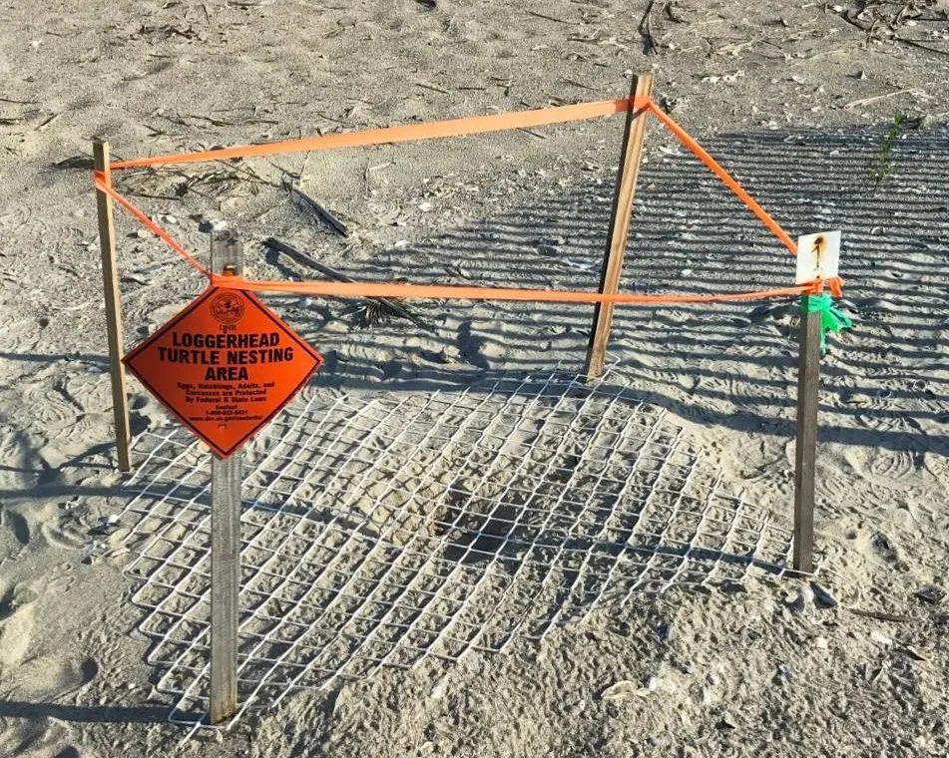
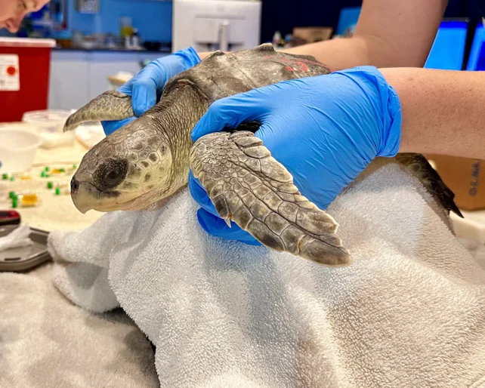
Rehabilitation and conservation efforts of Loggerhead turtles lack microbial community research
Safeguard females and nesting areas
Rehabilitate injured or sick
Microbiota?
Antonio Mazaris et al. 2017
Notes:
Most conservation efforts involve safeguarding females and their nesting area or rehabilitating injured or sick turtles.
But there’s a lack of knowledge in the microbiomes associated with these turtles

Slide 6
Rehabilitation and conservation efforts of Loggerhead turtles lack microbial community research
Safeguard females and nesting areas
Rehabilitate injured or sick
Microbiota?
Antonio Mazaris et al. 2017
Notes:
Most conservation efforts involve safeguarding females and their nesting area or rehabilitating injured or sick turtles.
But there’s a lack of knowledge in the microbiomes associated with these turtles

Slide 7
Rehabilitation and conservation efforts of Loggerhead turtles lack microbial community research
Safeguard females and nesting areas
Rehabilitate injured or sick
Microbiota?
Antonio Mazaris et al. 2017
Notes:
But there’s a lack of knowledge in the microbiomes associated with these turtles
Such information is crucial for understanding loggerhead biology and can aid efforts in recognizing and treating sick turtles.

Slide 8
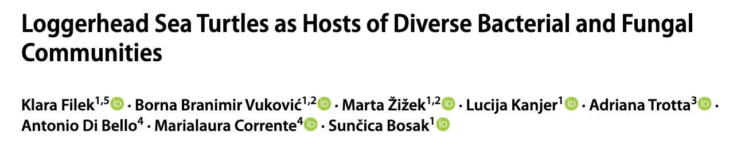
Rehabilitation and conservation efforts of Loggerhead turtles lack microbial community research
Safeguard females and nesting areas
Rehabilitate injured or sick
Microbiota?
Antonio Mazaris et al. 2017
Notes:
The paper my dataset is from aimed to start filling in this gap by analyzing the microbes from different parts of loggerhead turtles

Slide 9
How does microbial diversity of loggerhead sea turtles change with age?
Null Hypothesis: Alpha and beta diversity do not vary with age.
Alternative Hypothesis #1: Alpha diversity increases with age.
Alternative Hypothesis #2: Microbial composition will become more similar with age.
Alternative Hypothesis #3: Rare members are unique to juveniles compared to adults.
Notes:
Although this research is more exploratory, I had the most interest in exploring the microbial communities of turtles with different ages
My overarching scientific question was How does microbial diversity of loggerhead sea turtles change with age.
#1 – diet diversification and new environmental exposure with aging can introduce new microbes
#2 – internal environment becomes more stable with age
#3 – young are starting to build up their microbiome and it has not stabilized yet

Slide 10
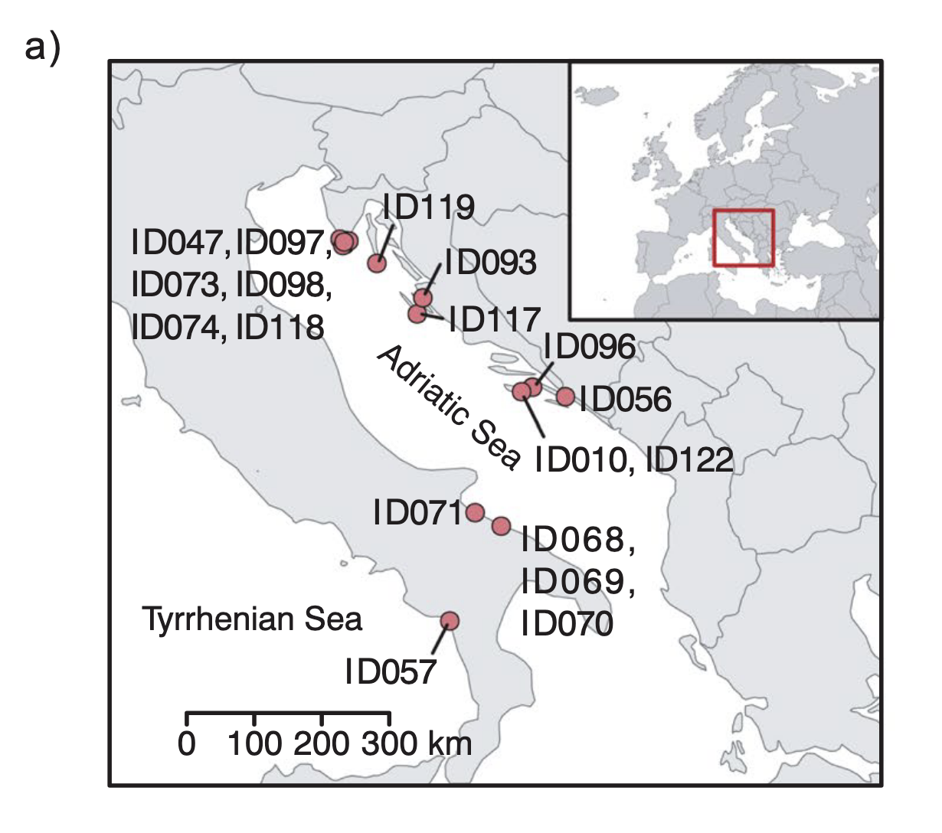
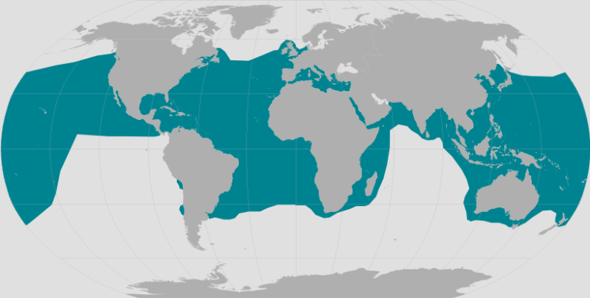
Loggerhead sea turtles (Caretta caretta) are a widely distributed species
Klara Filek et al. 2024
Notes:
Before we get into results, I want to explain a little bit about the methods
Loggerhead sea turtles are a widely distributed species, but this research is based on those from the Adriatic Sea near Italy.
Turtles were found strained, injured, or unintentionally caught by fishermen and transported to recovery centers where they received appropriate treatment.

Slide 11
Loggerhead sea turtles (Caretta caretta) are a widely distributed species
18 Turtles Sampled
10 Juveniles, 4 Sub-adults, 4 Adults
Cloacal, Oral, Tank Water
Klara Filek et al. 2024

Slide 12
Loggerhead sea turtles (Caretta caretta) are a widely distributed species
16S Amplicon Sequencing
V34 region
Klara Filek et al. 2024

Slide 13
How does microbial diversity of loggerhead sea turtles change with age?
Null Hypothesis: Alpha and beta diversity do not vary with age.
Alternative Hypothesis #1: Alpha diversity increases with age.
Alternative Hypothesis #2: Microbial composition will become more similar with age.
Alternative Hypothesis #3: Rare members are unique to juveniles compared to adults.
Notes:
First looking at alpha diversity

Slide 14
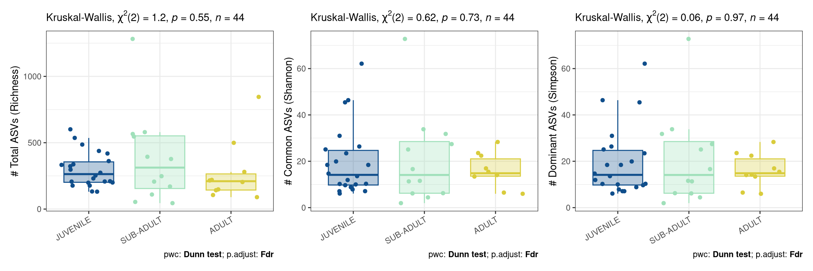
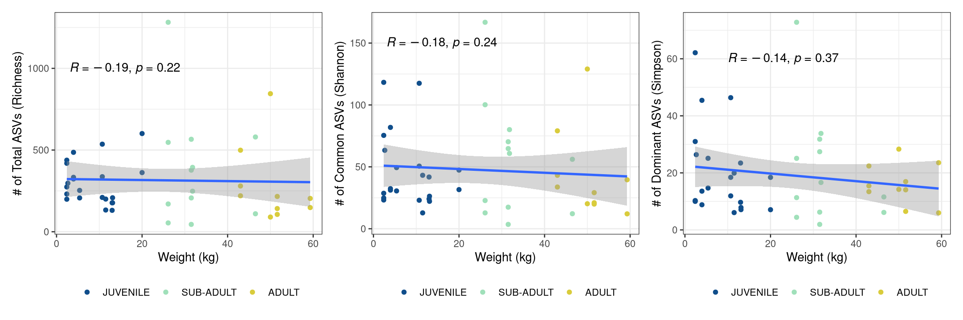
ASVs (all, common, and dominant) do not differ among age groups
Notes:
to test Alpha diversity - Hill number metrics – richness, Shannon, and Simpson
data was not normal - Kruskal-Wallis test followed by Dunn’s test
In each alpha diversity metric, the p value > 0.05.
ASVs (all, common, and dominant) do not differ among age groups.
Using weight as a continuous variable proxy for age, I used Spearman correlations and again found no significant correlation between weight and #ASVs
where p value > 0.05

Slide 15
ASVs (all, common, and dominant) do not differ among age groups
How does microbial diversity of loggerhead sea turtles change with age?
Null Hypothesis: Alpha and beta diversity do not vary with age.
Alternative Hypothesis #1: Alpha diversity increases with age.
Alternative Hypothesis #2: Microbial composition will become more similar with age.
Alternative Hypothesis #3: Rare members are unique to juveniles compared to adults.
Notes:
I cannot reject my null hypothesis with regards to alpha diversity, as alpha diversity does not increase with age

Slide 16
How does microbial diversity of loggerhead sea turtles change with age?
Null Hypothesis: Alpha and beta diversity do not vary with age.
Alternative Hypothesis #1: Alpha diversity increases with age.
Alternative Hypothesis #2: Microbial composition will become more similar with age.
Alternative Hypothesis #3: Rare members are unique to juveniles compared to adults.
Notes:
Beta diversity and microbial composition

Slide 17
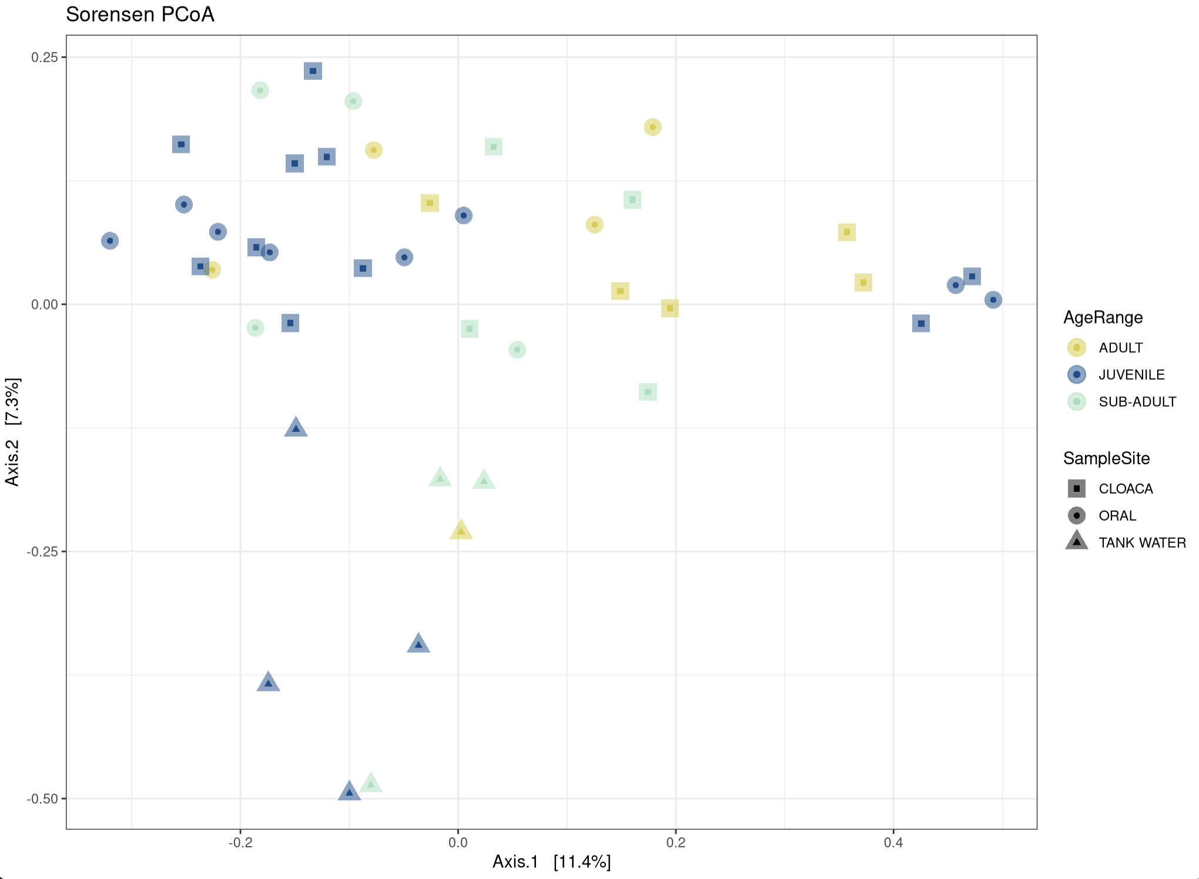
Age range and sample site are major drivers of community composition based on presence/absence
Notes:
Showing PCoA of Sorensen Dissimilarity – explains ~18% of variation in this dataset
Used presence/absence metric because I was interested in rare species
Division of samples based on sample site – Tank water triangles separate on axis 2
But no clear division based on age range
However, with a PERMANOVA test, Age range and sample site both had significant p values < 0.002 with R2 values of 0.07 and 1.0 and F-stats of 1.7 and 2.2
Additionally, with betadisper and permutest, neither had significant p values, so these PERMANOVA tests likely represent true differences
Since this is presence/absence dissimilarity, it suggests an effect on rare species.
Overall, age range and sample site are major drivers of community composition based on presence/absence

Slide 18
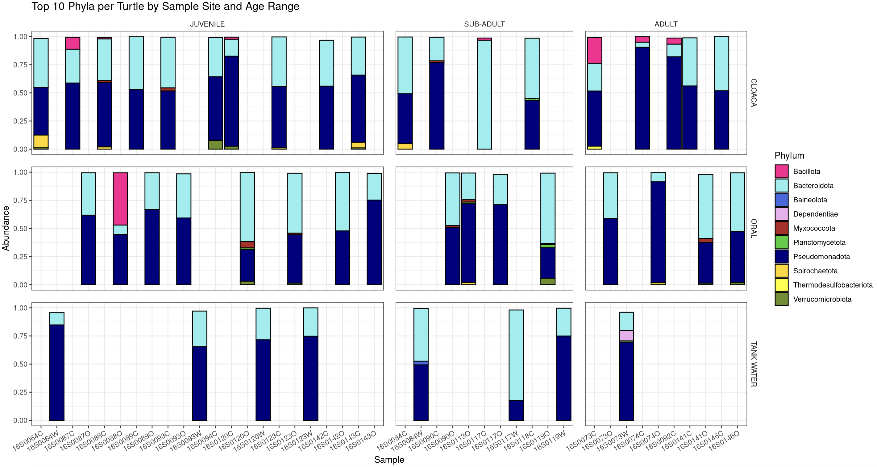
Bacteroidota and Pseudomonadota have the highest relative abundance in almost all samples
Notes:
Now that I know sample site is also a major driver of community composition with age, I am including it with my analyses
Relative abundances for each sample
Bacteriodota and Pseudomonadota have the highest relative abundance in almost all samples
No age range looks more compositionally similar than the others

Slide 19
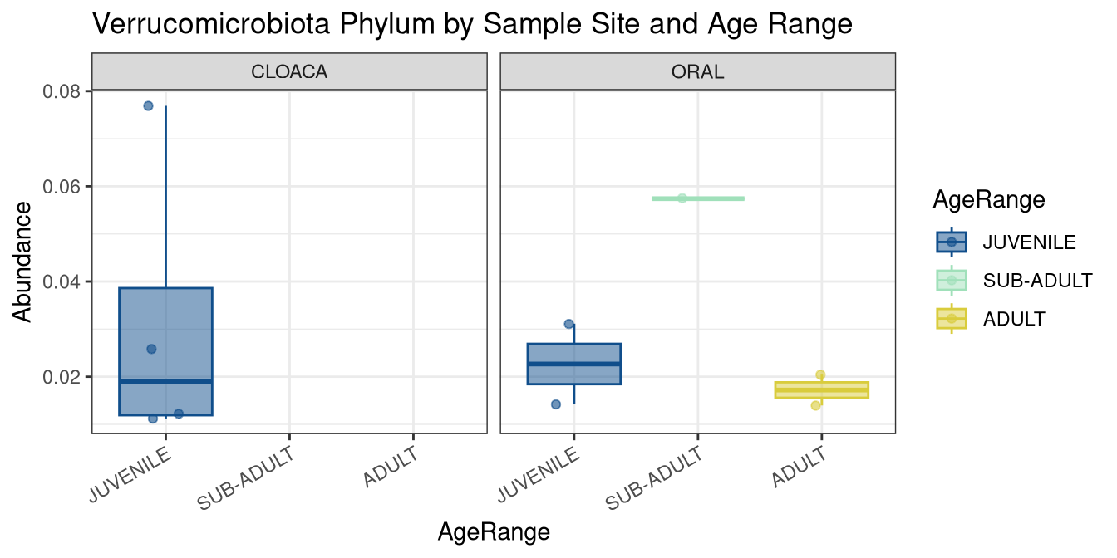
Phylum Verrucomicrobiota appears more often in juvenile (cloaca)
Notes:
Paper said Verrucomicrobiota appears more often in juveniles
But I only found that to be the case in juvenile cloacal samples
Completely missing in sub-adult and adult cloaca
Only has a few described species

Slide 20
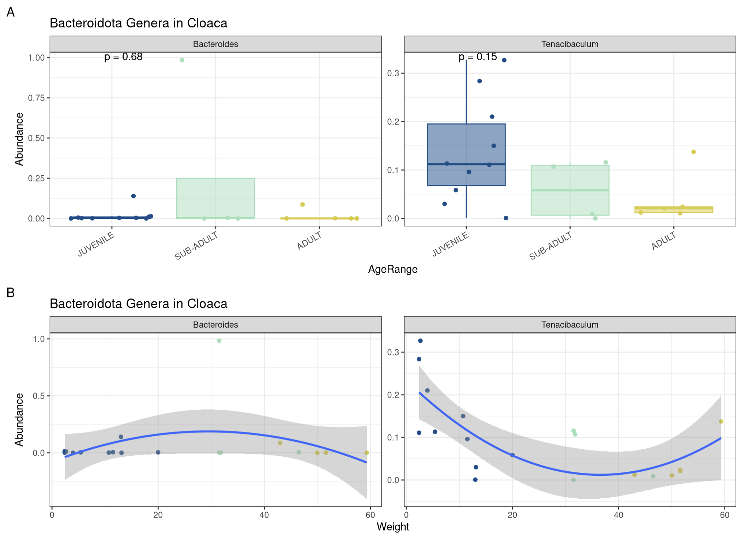
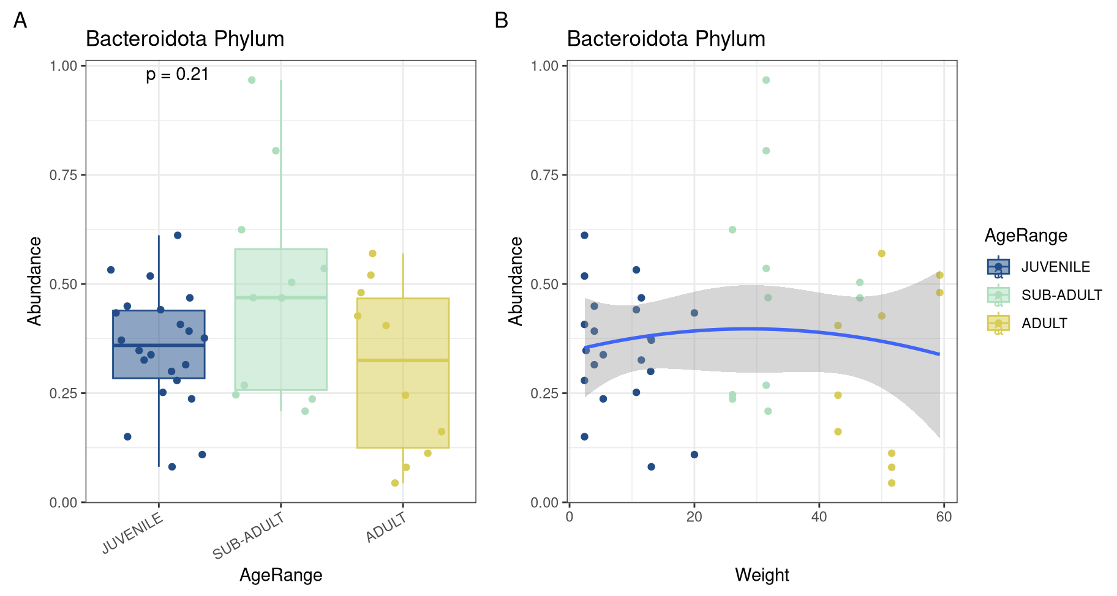
Phylum Bacteroidota not differentially abundant between ages but Tenacibaculum may have higher abundance in juvenile cloaca
Notes:
Paper said Bacteroidota appear more in adults, which just isn’t the case based on relative abundance.
However, when looking at Bacteroidota genera, the genus Tenacibaculum may have higher abundance in juvenile cloaca, even though it is not a significant difference based on Kruskal Walis
Important -Tenacibaculum species are marine pathogens and suggests juveniles may be more at risk of infection

Slide 21
How does microbial diversity of loggerhead sea turtles change with age?
Null Hypothesis: Alpha and beta diversity do not vary with age.
Alternative Hypothesis #1: Alpha diversity increases with age.
Alternative Hypothesis #2: Microbial composition will become more similar with age.
Alternative Hypothesis #3: Rare members are unique to juveniles compared to adults.
?
Notes:
Did not see microbial composition become more similar with age
Rare members - wasn't able to directly test this
slightly higher R2 and F-stat for age range in Sorensen dissimilarity than Bray-Curtis, suggesting some affect on rare species ?

Slide 22
How does microbial diversity of loggerhead sea turtles change with age?
Alpha diversity (richness, Shannon, and Simpson) does not change with age.
Age range and sample site are major drivers of community composition based on presence/absence.
No age range was more compositionally similar.
Some microorganisms may have higher relative abundance in juvenile cloaca, including phylum Verrucomicrobiota and genus Tenacibaculum.
Notes:
Summarize what I found about how microbial diversity of loggerhead sea turtles with age

